Slide 1
Origins of the Intergroup/Central Office/Central Committee and the General Service Conference
For the Delegate Area 50 Assembly …. Hosted by the Buffalo Area AA Central Office!
January 11, 2025

Slide 2
A.A.’s First Central Committee
Cleveland, Ohio in 1939
Committee of 7: 5 men, 2 women
Thought to be first example of rotation
Initially to coordinate efforts regarding hospitalization and sponsorship

Slide 3
A.A.’s First Intergroup/Central Office
Chicago, IL in 1940
One-room office – organized service center and
New York, NY in 1940
Local service center operating informally out of an AA clubhouse at 334 ½ West 24th Street
Hub of AA activity on local level

Slide 4
Intergroup/Central Office/Central Committee
Tradition 9:
AA has always violently resisted the idea of any general organization. Yet, paradoxically, we insist upon organizing certain special services; mostly those absolutely necessary to effective and plentiful 12th Step Work. Bill W., August 1948 Grapevine.
Tradition 8:
Defines the role of service centers, boards and committees as providing service, rather than exercising any form of governance.
Reminding us that AA ought to be no more organized than is minimally necessary to maintain a service structure.
We are not organized to impose governance; we are
ORGANIZED FOR SERVICE.

Slide 5
What about the General Service Conference?

Slide 6
Concept I
Final responsibility and ultimate authority for A.A. world services should always reside in the collective conscience of our whole fellowship.
Did you know?
Long Form Concept I= Short Form for Concept I
They made it easy!
January 9, 2025

Slide 7
Concept I Definitions:
Responsibility: accountability, or obligation to perform certain functions.
Ultimate: final.
Authority: the power or right to give orders, make decisions.

Slide 8
Concept I Definitions:
Responsibility: accountability, or obligation to perform certain functions.
Ultimate: final.
Authority: the power or right to give orders, make decisions.

Slide 9
Concept I and …….
Tradition II
Final responsibility and ultimate authority for A.A. world services should always reside in the collective conscience of our whole fellowship.
For our group purpose there is but one ultimate authority – a loving God as He may express Himself in our group conscience. Our leaders are but trusted servants: they do not govern.

Slide 10
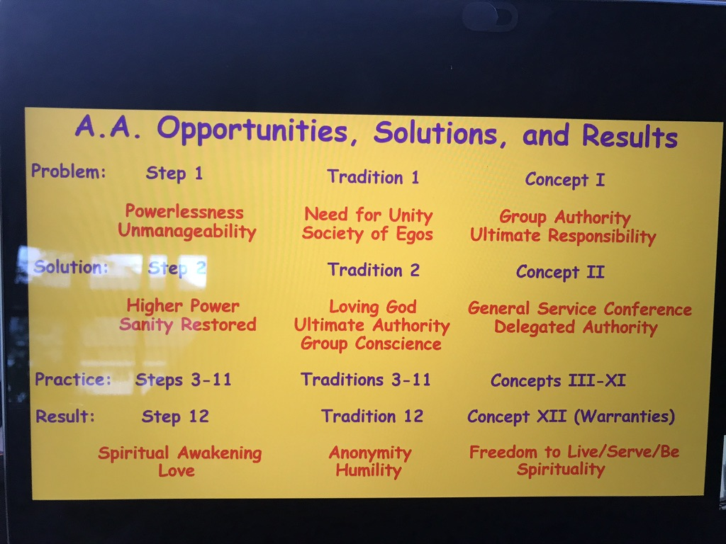
Concept I
Thank you to Don B., Panel 68, Area 29 (Maryland) Delegate
for permission for the use of a screen shot of his presentation slide (which he said I didn’t need permission for nor needed to attribute it to him!)

Slide 11
Concept I and Tradition II
Final responsibility and ultimate authority for A.A. world services should always reside in the collective conscience of our whole fellowship.
For our group purpose there is but one ultimate authority – a loving God as He may express Himself in our group conscience. Our leaders are but trusted servants: they do not govern.
How do we achieve this collective conscience of the WHOLE fellowship?
(stating as a ”problem”)…
…so that our fellowship is and remains under the care and protection of God?

Slide 12
Concept I
The Alcoholic Foundation was created in 1938
(Fun Fact: The Foundation was renamed The General Service Board of Alcoholics Anonymous in 1954…its members are the Trustees of A.A.)
Bill W. and Dr. Bob were still asked to advise on any and all A.A. Policy Questions
Uniform Literature
Public Relations
Answer Pleas for Help
Counsel and Aid New Groups
Monthly Magazine
Translation of our Literature

Slide 13
Concept I
The Alcoholic Foundation was created in 1938
(Fun Fact: The Foundation was renamed The General Service Board of Alcoholics Anonymous in 1954…its members are the Trustees of A.A.)
Bill W. and Dr. Bob were still asked to advise on any and all A.A. Policy Questions
Uniform Literature
”By whose authority do the trustees speak for us?”
Public Relations
“And how do they know they are right?”
Answer Pleas for Help
Counsel and Aid New Groups
Monthly Magazine
Translation of our Literature

Slide 14
Concept I
Since 1938, our friends (the Non-alcoholic Trustees of the Alcoholic Foundation) had been holding our Third Legacy, Service, in trust for us.
But now…now meaning, beginning in 1948:
Bill W. and Dr. Bob were perishable
A.A. was out of its infancy, and has full right and plain duty to take direct responsibility
Their friends, the Trustees, were almost unknown to the A.A. Movement
The Foundation (the GSB) must be anchored to the movement or a Headquarters breakdown is inevitable
In future years, the Trustees couldn’t function without direct guidance from A.A.
How would the Trustees handle an emergency without a reliable cross section of A.A. opinion

Slide 15
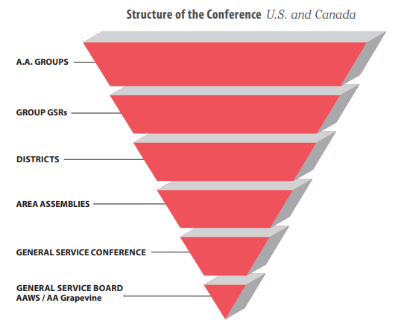
Concept I
Ultimate Authority: Concept 1 and Tradition 2
The groups and God
Between 1948 and 1950, Bill W. worked on his bold solution, that the leadership of A.A. would be the collective conscience of the GROUPS in A.A!
Delegated Authority:
The Trusted Servant
(The whole rest of the triangle “below the group”)

Slide 16
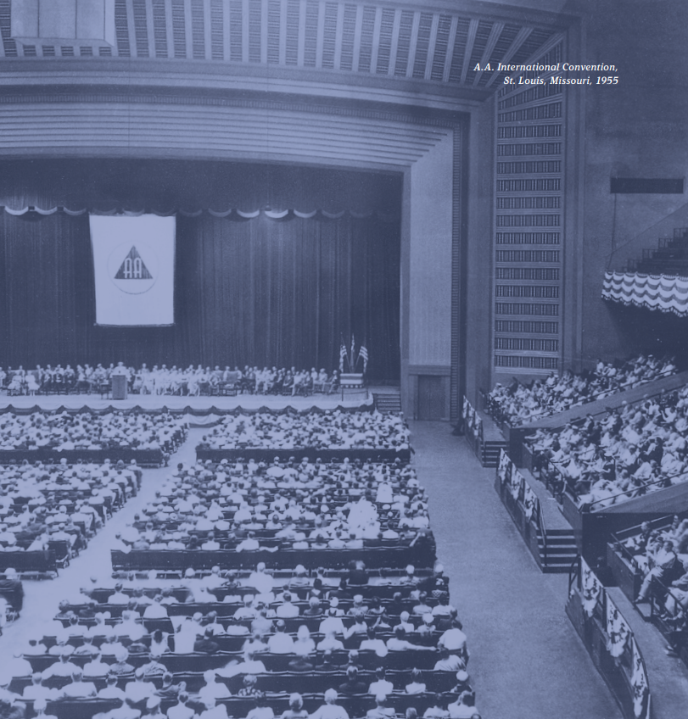
Concept I
Abbreviated Timeline for A.A. to Accept Responsibility for our Third Legacy:
July 1950, First International Convention ratifies 5- year experimental General Service Conference
April 1951, First General Service Conference
July 1955, 20th Anniversary Convention at St. Louis where the Three Legacies of Recovery, Unity and Service were turned over to the movement by its old-timers!

Slide 17
Concept I
“We have heard with approval Bill W.’s proposal that A.A.’s General Service Conference should now become the permanent successor to the founders of Alcoholics Anonymous, inheriting from them all their former duties and special responsibilities, thus avoiding in future time all possible strivings for individual prestige or personal power; and also providing our Society with the means of functioning on a permanent basis.”
-from the Resolution Authorizing the General Service Conference, July 3, 1955.
Abbreviated Timeline for A.A. to Accept Responsibility for our Third Legacy
July 1950, First International Convention ratifies 5- year experimental General Service Conference
April 1951, First General Service Conference
July 3, 1955, 20th Anniversary Convention at St. Louis where the Three Legacies of Recovery, Unity and Service were turned over to the movement by its old-timers!
See appendix L of service manual

Slide 18
Concept I
From the Report of the first annual General Service Conference of Alcoholics Anonymous, 1951
“The General Service Conference was evolved not to govern A.A. in any sense but to serve the entire movement. The Conference serves A.A. by assuming responsibility for basic direction of the General Service Office in New York and by advising the Alcoholic Foundation (now the GSB of AA), the custodian of A.A. policy and tradition at the national level.”
History and development of AA and relationship between “GSB”, GSO (AAWS), and AA Grapevine.
Delegates required increased knowledge and understanding of the following:
Nature and scope of services now rendered by the GSO (AAWS)
Nature and scope of services now rendered by A.A. Grapevine
How the various AA service agencies are financed and the present financial status of each

Slide 19
The Solution: Delegated Authority or “the trusted servant”
Concept II: When, in 1955, the A.A. groups confirmed the permanent charter for their General Service Conference, they thereby delegated to the Conference complete authority for the active maintenance of our world services and thereby made the Conference – excepting for any change in the Twelve Traditions or in Article 12 of the Conference Charter-the actual voice and the effective conscience for our whole Society.
See Appendix K of the A.A. Service Manual for the Conference Charter

Slide 20
How do we work together?
Communication is the key to working together.
Get together with corresponding committees
Complementary rather than competitive A.A. operations
1990 recommendation that delegates establish and maintain contact with offices in their area to share Conference information and assure that intergroup/central offices have a voice in the Fellowship through the existing service structure.
Both exist to insure A.A. unity and to fulfill our primary purpose of carrying the message.
See Appendix S of the A.A. Service Manual for General Service and Intergroup/Central Offices

Slide 21

Sources:
The A.A. Service Manual combined with Twelve Concepts for World Service, by Bill W., Alcoholics Anonymous World Services, Inc., 2024-2026 Edition.
Alcoholics Anonymous Comes of Age, Alcoholics Anonymous World Services, Inc., 1957.
Report of the first annual General Service Conference of Alcoholics Anonymous, 1951.
Final Report of the second annual General Service Conference of Alcoholics Anonymous, 1952.
Final Report of the fifth annual General Service Conference of Alcoholics Anonymous, 1955.
“On the Nineth Tradition”, by Bill W., Grapevine, August 1948 issue.
”Your Third Legacy”, Bill W., Grapevine, December 1950 issue.
”Services Make A.A. Tick”, Bill W., Grapevine, November 1951 issue.
Don B., Area 29 (Maryland), Panel 68 Delegate for the use of his problem, solution, practice, result slide.
Linda R., “A fellowship without rules and regulations.”
All those who came before us, and have allowed us to stand on their shoulders.

