Slide 1





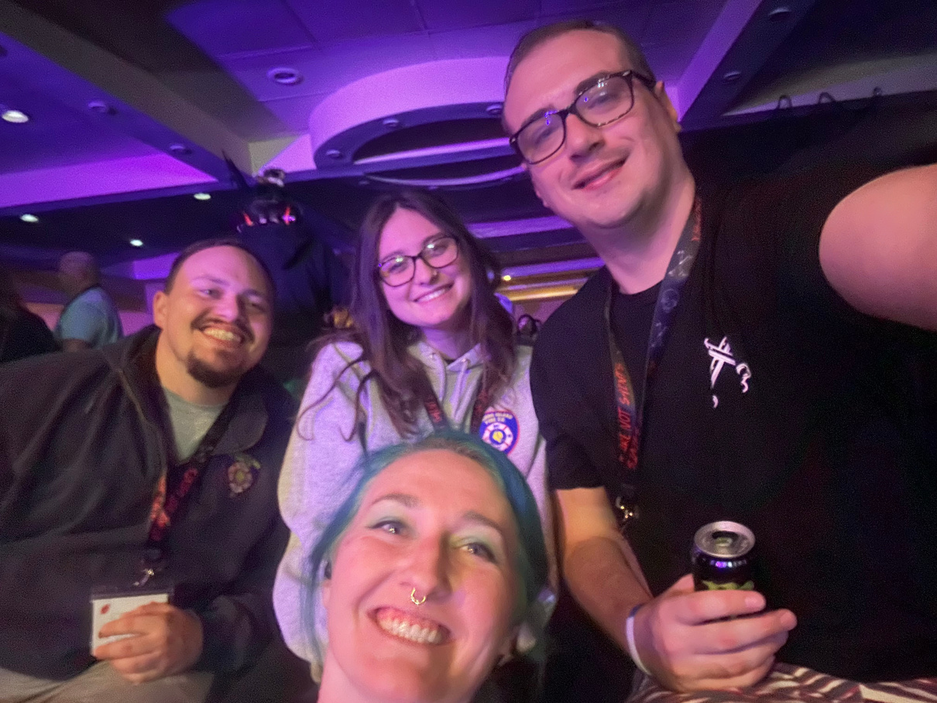
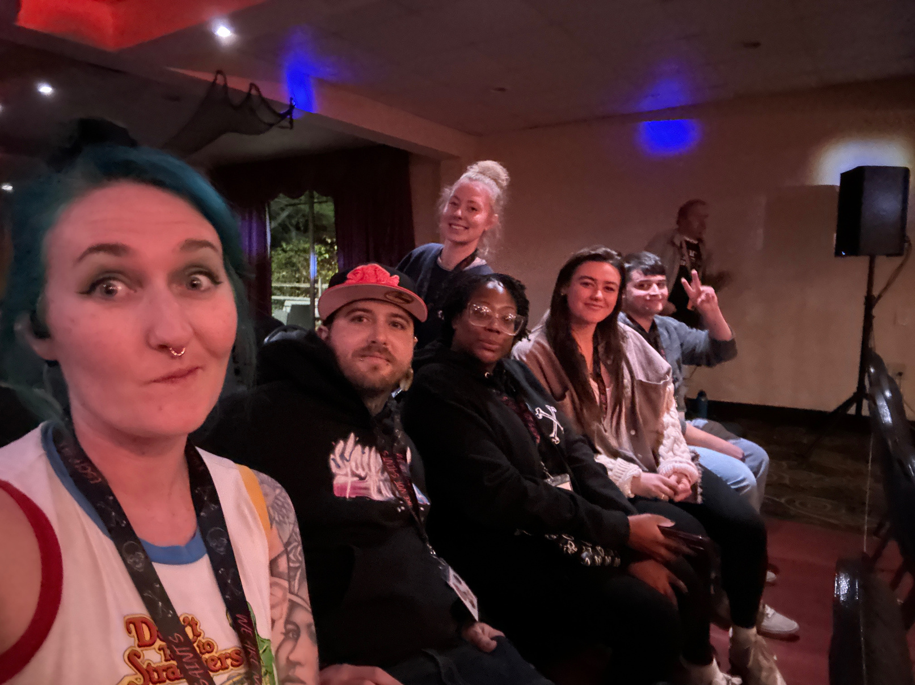

INTRODUCING
BUFFYPAA
Buffalo Young People
in Alcoholics Anonymous

Slide 2
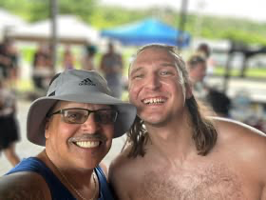
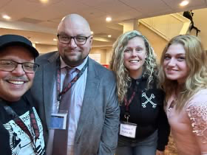
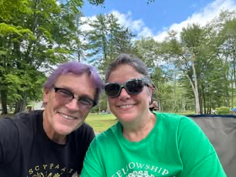
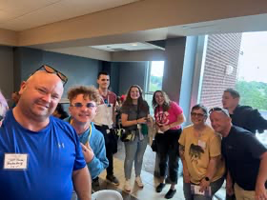
WHAT IS
BUFFYPAA?
We are simply sober members of Alcoholics Anonymous who live in the Western New York area.
YPAA comes from Young People in Alcoholics Anonymous.
Don’t worry – “young” simply means room to grow!
Notes:
This is not a meeting but a group that performs service outside the home group to find ways to carry the message. Similar to GSA and Intergroup but on a smaller scale.
YPAA comes from Young People in Alcoholics Anonymous. By this we mean someone who declares themselves an alcoholic and has become sober at an early age. This includes alcoholics in general who are young at heart and have room to grow in their sobriety.

Slide 3
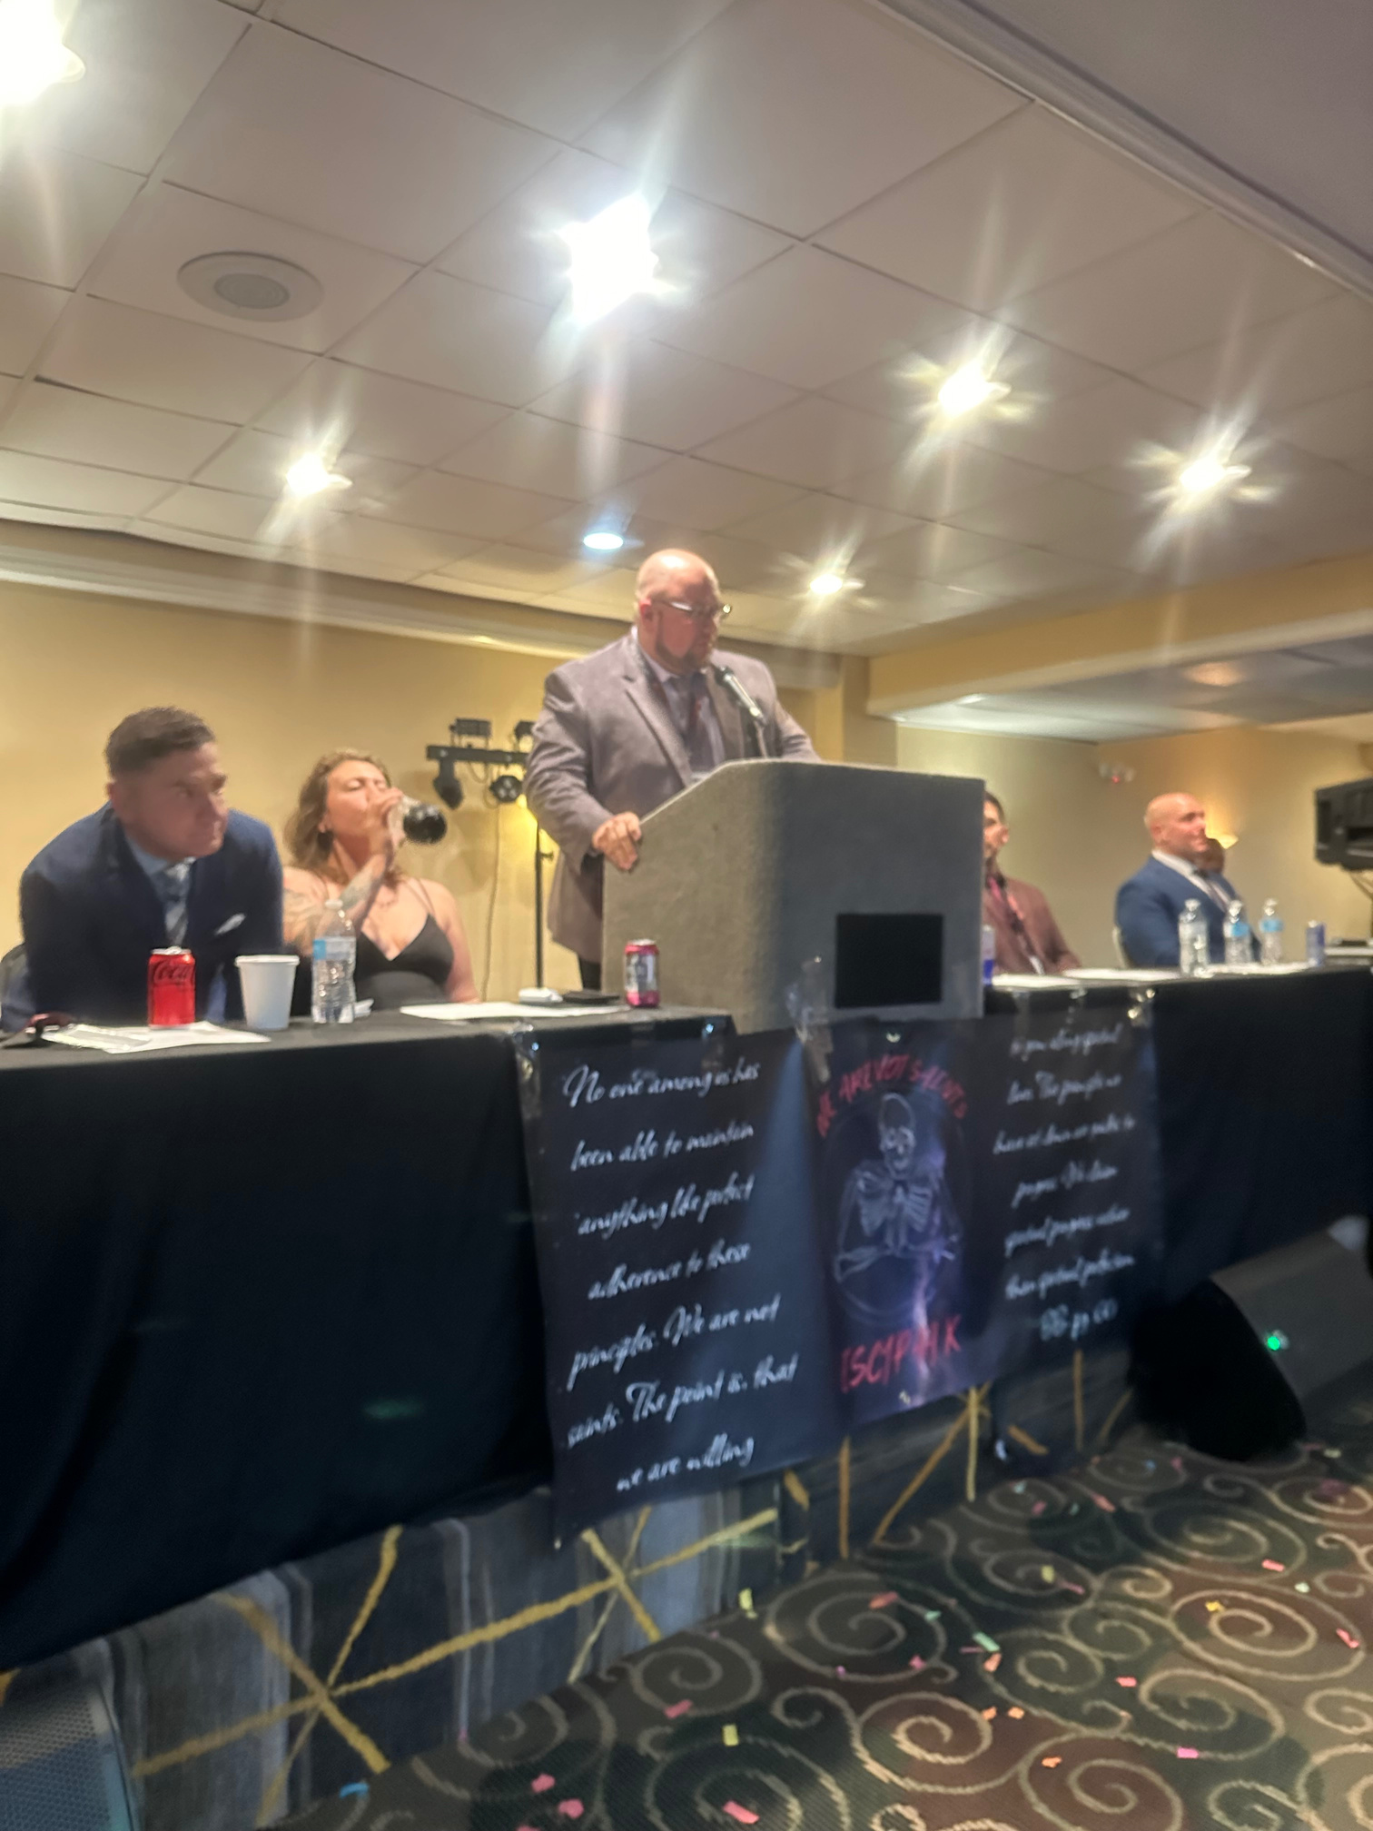
IS YPAA
PART OF AA?
YES!!
Notes:
Short answer to this question is YPAA definitely part of the overall AA service structure. To the left is one of our current members giving a keynote talk at the 10th annual Empire State Convention of YPAA aka ESCYPAA last year in Poughkeepsie, New York. This is a big example of BUFFYPAA simply doing what AA was formed to do, share our experience, strength, and hope with each other of how we solved our common problem.

Slide 4
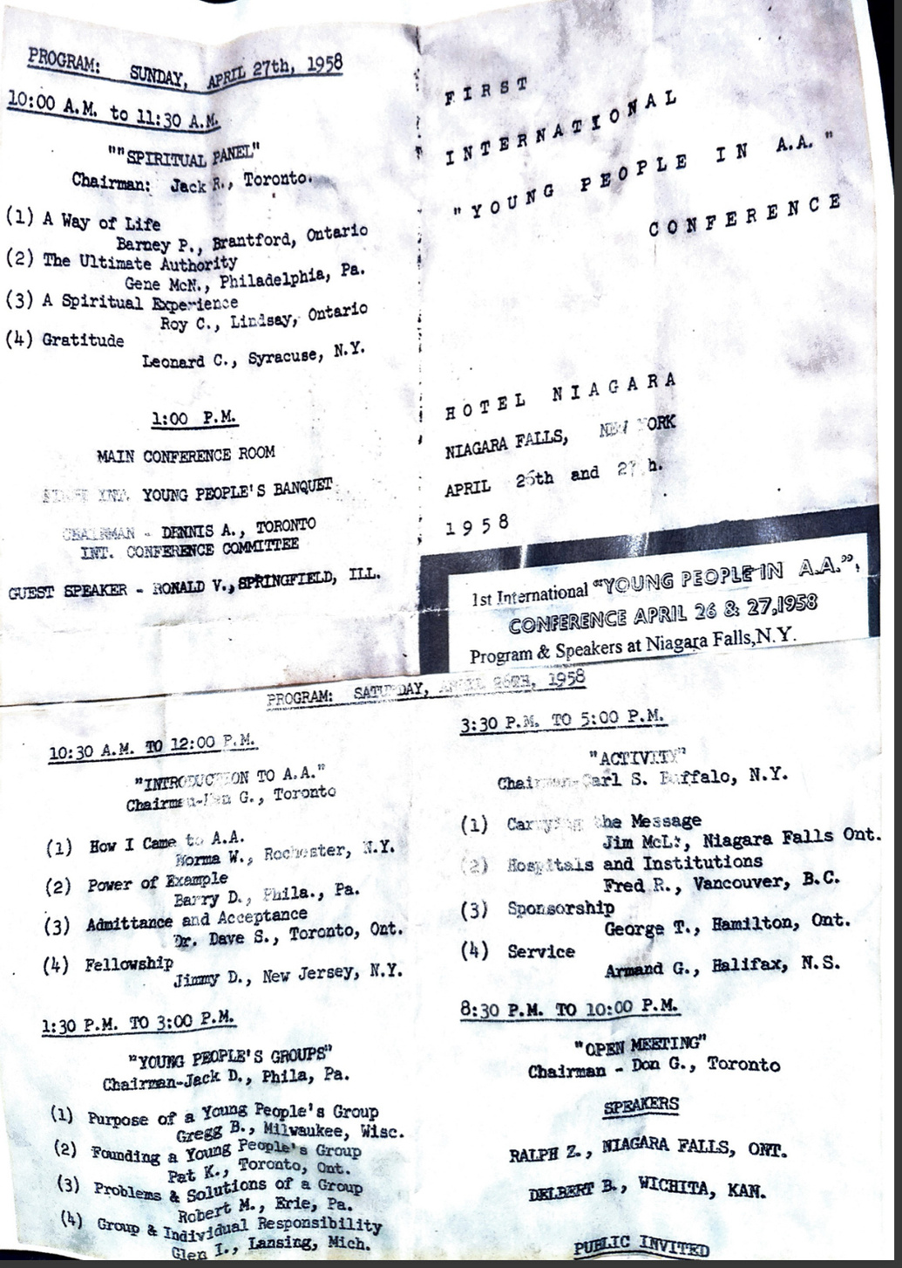
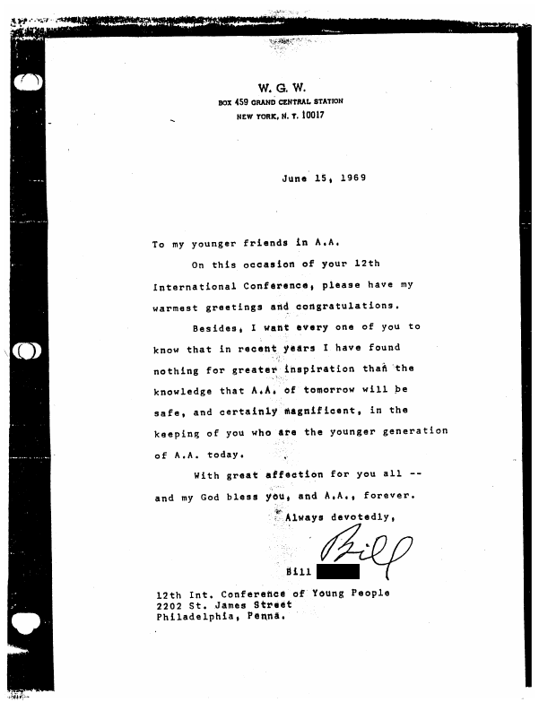
WHY IS YPAA
PART OF AA?
Notes:
Young People's Groups in Alcoholics Anonymous began appearing around 1945 in Los Angeles, Cleveland, and Philadelphia, and now they can be found all across North America. In 1958, the first International Young People of AA's convention was held in Niagara Falls, NY, at Hotel Niagara, and it has met on an annual basis ever since. At the 1960 AA Convention, Bill W. noted that the age of new members was much lower than when he and Dr. Bob founded AA 25 years earlier. In a letter to ICYPAA dated June 15, 1969, Bill wrote (read letter in image).

Slide 5
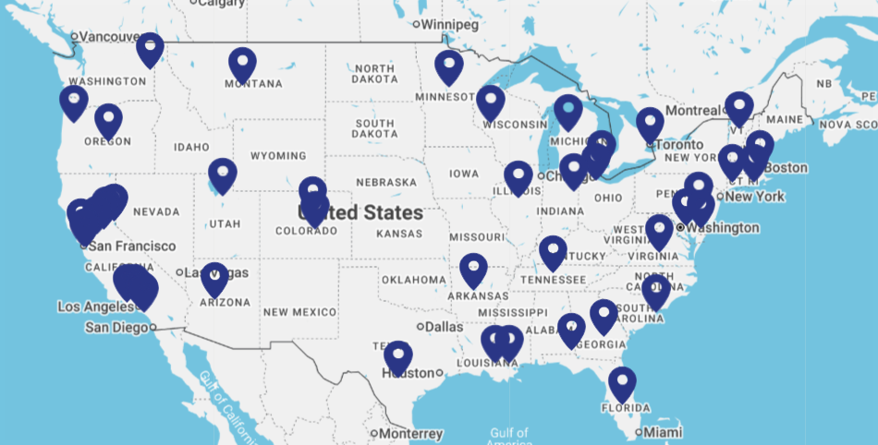
YPAA DIRECTORY
Notes:
Like AA in general, YPAA is all over the globe! This shows just some of the examples of where we are in the continental United States. Not pictured is also Hawaii, Alaska, Australia, the United Kingdom, and more. As in this program, we are not alone!

Slide 6

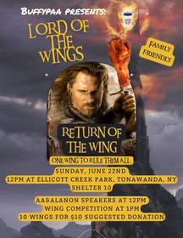
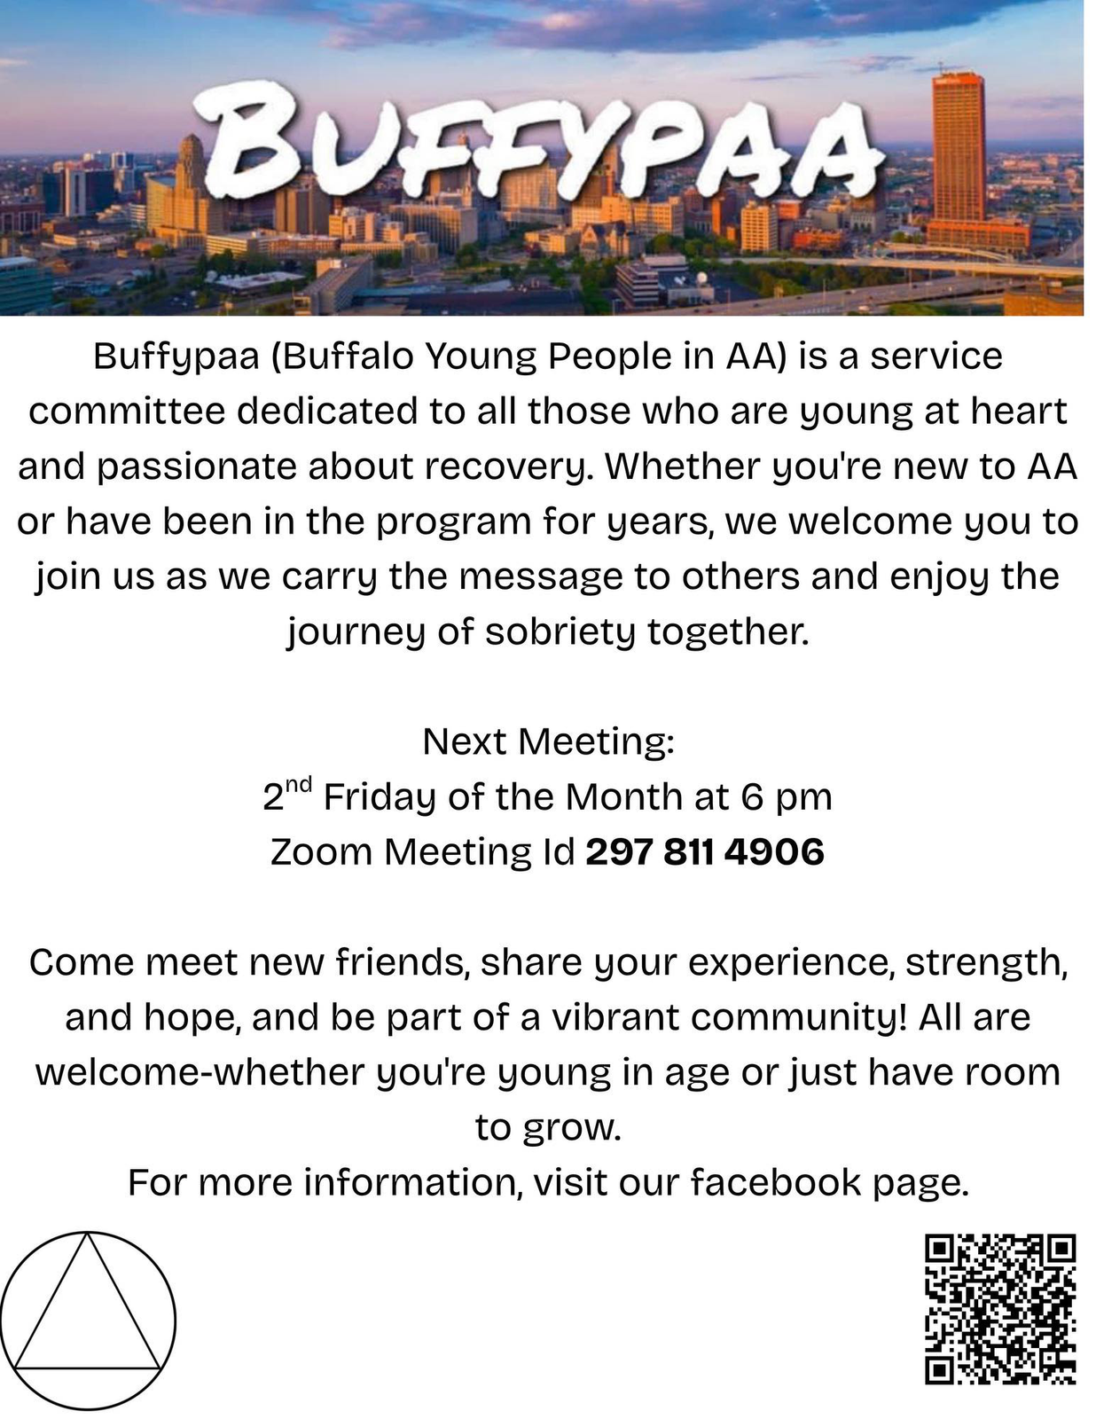

WHAT SERVICE
ARE WE DOING?
FELLOWSHIP
SPEAKER PANELS
LITERATURE
FOOD AND FUN
Notes:
Service wise as a committee we work towards creating ideas and putting forth the action to create events that include panels, speakers, food, friendly competitions, and overall fellowship! The QR code on the slide will send you to our Facebook page that you can request to join to stay informed on what BUFFYPAA is up to.

Slide 7
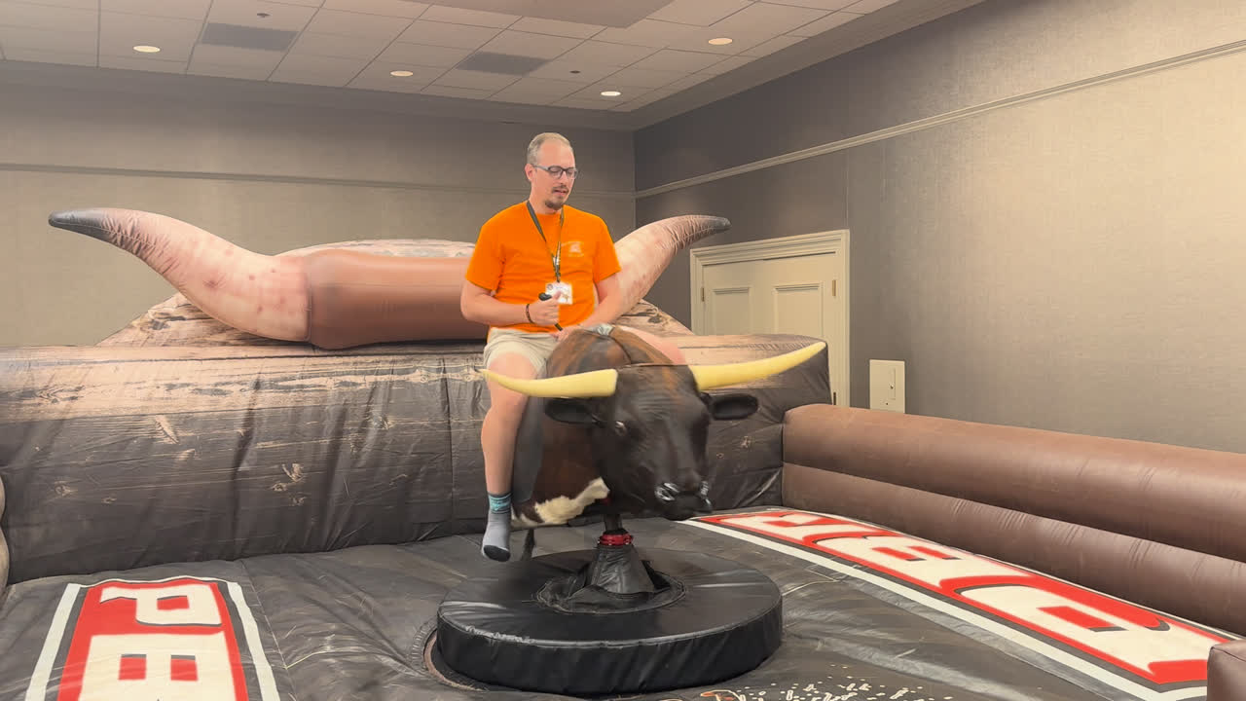
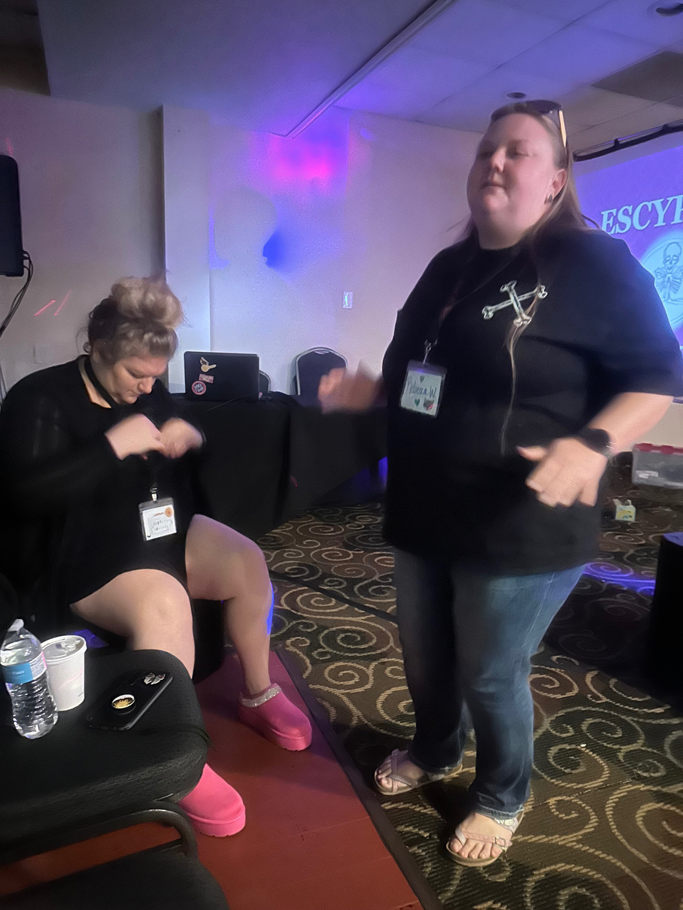
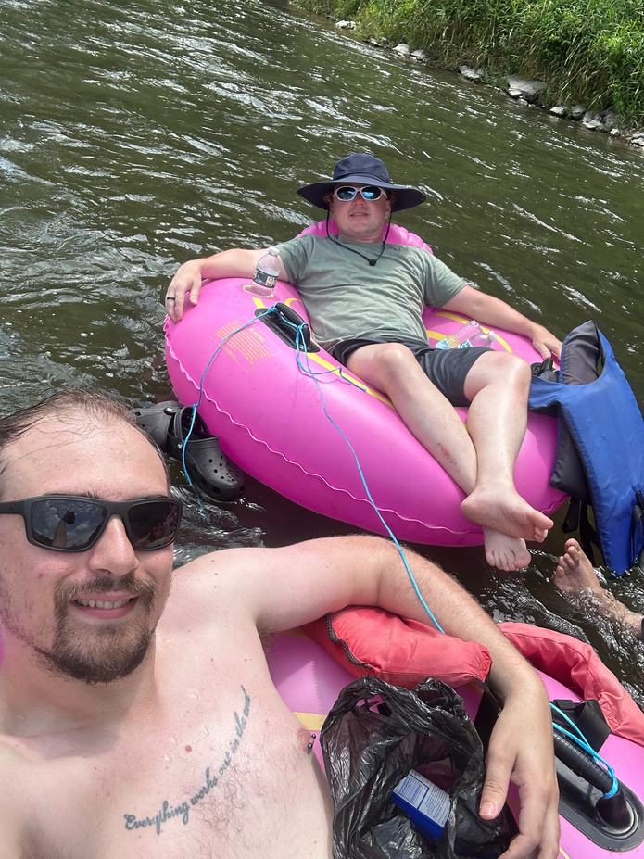
WE HAVE FUN WHILE
WE REPRESENT
Notes:
These pictures show some familiar members of our fellowship having fun while sober. Whether it is floating down a river with one another, dancing our butts off during a convention, or even riding a fake bull at an event in another state across the country! YPAA shows that people in AA as a whole are not a glum lot!

Slide 8
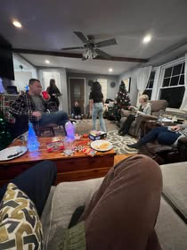
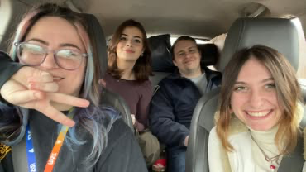
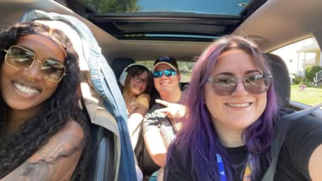

SHARING
THE WORK
Carpool to other YPAA events
Attend AA meetings together
Sit together at AA interest tables
Attend monthly business meetings and subcommittee meetings to coordinate our AA service events.

Slide 9
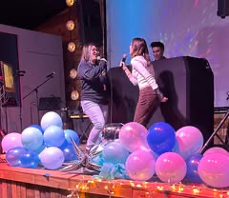
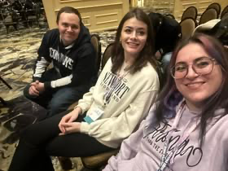
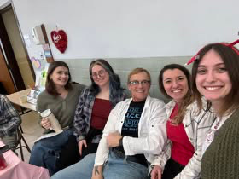
THIS IS A ‘WE’ PROGRAM
WE NEED TO COME TOGETHER
Notes:
BUFFYPAA is a small part of the giant whole which is YPAA and the overall AA service structure. We need anyone that is:
1. An alcoholic with a desire to stop drinking.
2. Be young at heart (age really does not matter)
This is a small part of doing service outside of the home group. This is not just another AA meeting/group.

Slide 10
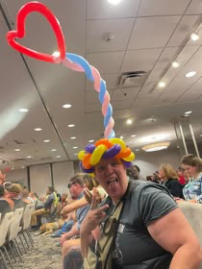


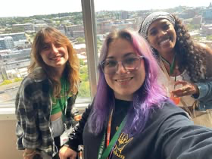
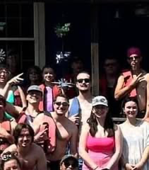
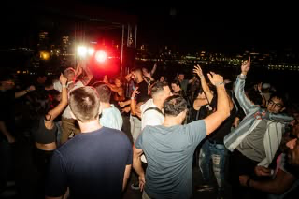

Slide 11
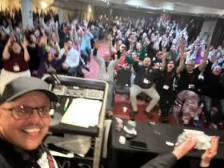
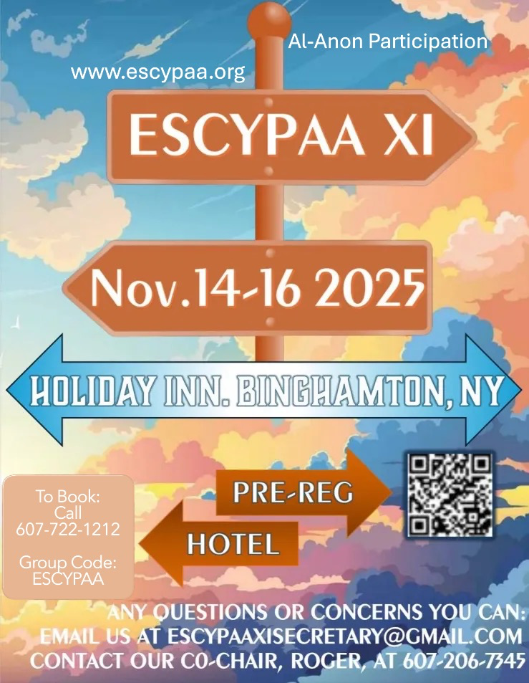
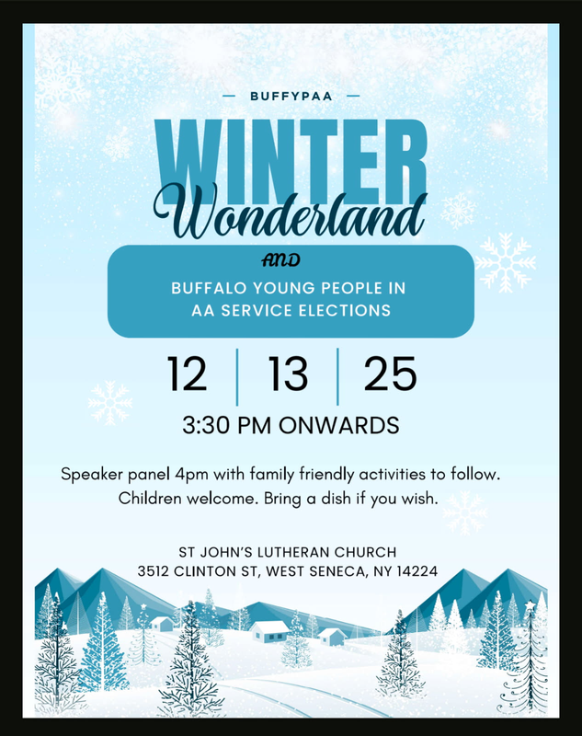
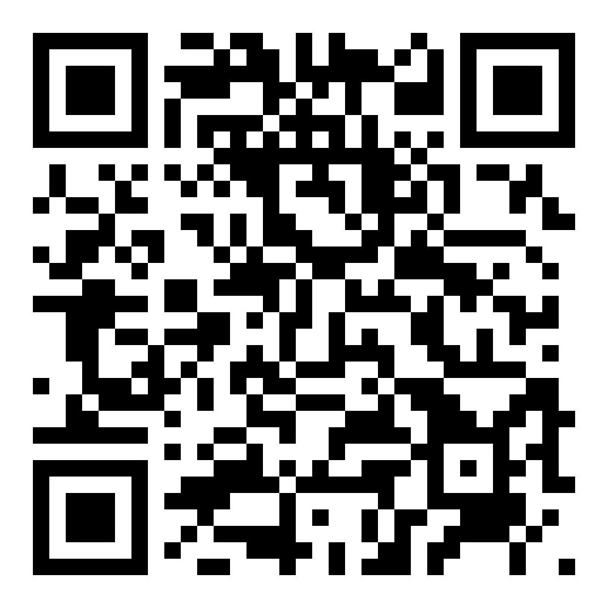

THANK
YOU
Facebook Page
Notes:
Thank you area 50 for allowing BUFFYPAA to present here today. To be honest this presentation alone would not convince a newcomer or anyone to join YPAA more than going to an actual convention. New York State will be holding their's next weekend in Binghamton, NY. This will be the 11th ESCYPAA aka the Empire State Conference of Young People in AA. Just gather yourselves and others and get in the car! In my experience you will not regret it. Maybe someday it can be held in Buffalo again, but we cannot do it alone! Lastly, please consider coming to our next event with your chance to join the committee since we will have our annual elections. 12-13-25 3:30pm at St. John's Lutheran Church in West Seneca. Fun and games too!

